Slide 1

Title:smart online marketplace for loacal vendors
Student Name: B.pavan
Student ID: 2520040102
Cluster:01
Section: 01
Under the Guidance
of
Supervisor Name: Ramakanth sir
Assistant Professor
Department of ECE

Slide 2
Abstract
The Smart Online Marketplace for Local Vendors is designed to empower small-scale sellers by providing them with a digital platform to showcase and sell their products efficiently. Unlike conventional e-commerce systems, this marketplace focuses on inclusivity, accessibility, and community growth by integrating local vendors into a unified online ecosystem. The platform leverages modern web technologies and data structures to ensure seamless navigation, secure transactions, and personalized recommendations for buyers.
Key features include vendor registration, product catalog management, real-time inventory tracking, and location-based search to connect customers with nearby sellers. The system also incorporates analytics dashboards for vendors to monitor sales trends and customer preferences, enabling data-driven decision-making. By bridging the gap between traditional markets and digital commerce, the project fosters economic empowerment, enhances visibility for local businesses, and promotes sustainable community development.

Slide 3
Existing System
At present, local vendors primarily rely on traditional marketplaces or general e-commerce platforms (such as Amazon, Flipkart, or local grocery apps) to sell their products. These systems provide basic features like vendor registration, product listing, and online payment integration. However, they are often designed for large-scale sellers and lack customization for small, community-based vendors.
Traditional Marketplaces: Vendors sell directly to customers in physical markets. While this ensures personal interaction and trust, it limits reach, convenience, and scalability.
General E-commerce Platforms: Platforms like Amazon or Flipkart allow vendors to list products online. These systems offer wide visibility but involve complex onboarding, high commission fees, and competitive pressure from large brands. Small vendors often struggle to stand out or manage logistics effectively.

Slide 4
Proposed System
The Smart Online Marketplace for Local Vendors proposes a dedicated, vendor-friendly digital platform tailored to the needs of small businesses and community sellers. Unlike existing systems, this marketplace emphasizes simplicity, affordability, and local relevance.
Key Features of the Proposed System:
Vendor-Centric Design: Easy registration and product catalog management with minimal technical requirements.
Location-Based Search: Customers can discover nearby vendors and products, fostering community engagement and reducing delivery times.
Real-Time Inventory Management: Vendors can update stock instantly, ensuring accurate product availability for buyers.
Secure Transactions: Integrated payment gateways with options for cash-on-delivery to suit local preferences.

Slide 5
System Architecture
Responsive web/mobile interface for vendors and customers
Features: product browsing, vendor dashboards, shopping cart, checkout
Backend (Application Layer):
Handles business logic, authentication, order processing, and analytics
Implements algorithms for search, sorting, and recommendations
Database Layer:
Stores vendor profiles, product catalogs, customer accounts, orders, and analytics data
Multi-Tier Design: Divided into Presentation, Application, Database, and Integration layers for modularity and scalability.
Frontend (Presentation Layer):
.

Slide 6
Project Modules
Vendor Module
Vendor registration & login
Product catalog creation and updates
Real-time inventory management
Sales analytics dashboard
Customer Module
Customer registration & login
Product browsing with search & filters
Location-based vendor discovery
Shopping cart, checkout, and order tracking
Admin Module
Vendor approval & monitoring
Product/category management
Customer support & dispute handling
System-wide reporting
Product & Inventory Module
Product listing with details (price, description, images)
Stock updates and alerts

Slide 7
Objectives
Empower Local Vendors
Provide a simple, affordable digital platform for small businesses to showcase and sell their products.
Enhance Accessibility
Enable customers to discover nearby vendors through location-based search and recommendations.
Streamline Transactions
Integrate secure payment gateways and order management systems for smooth buying and selling.
Improve Inventory Management
Offer real-time stock updates to ensure accurate product availability.

Slide 8
Co’s Attainments - FWD
CO1 – Internet Fundamentals, HTML & Basic CSS
Designed the web page structure using HTML elements such as header, navigation bar, sections, tables, and forms.
Implemented basic CSS styling including colors, fonts, margins, borders, and layout to enhance the user interface.
Developed a structured web page layout for the smart online marketplace for local vendors System.
Applied fundamental web concepts to build a static and responsive webpage interface.

Slide 9
CO2 – HTML Forms & Advanced CSS
• Implemented HTML forms for admin input such as , item name, cost, quantity. • Used CSS styling techniques to design tables, buttons, and layout. • Applied responsive layout and structured UI for better user interaction. • Improved the visual design of the smart online market place for local vendors System interface.

Slide 10
CO3 – JavaScript Programming
• Implemented JavaScript functions to control the application logic. • Developed functions such as addcart(), deletecart(). • Used arrays and objects to manage food inventory data. • Enabled dynamic interaction between the user interface and data.

Slide 11
CO4 – DOM Manipulation & Web Storage
• Used DOM manipulation to update webpage content dynamically. • Implemented event handling for buttons and user actions. • Used browser localStorage to store and retrieve food inventory data. • Enabled real-time updating of inventory information.

Slide 12
CO5 – Advanced Web Development Concepts
• Developed an interactive web application for real-time food availability tracking. • Integrated frontend technologies (HTML, CSS, JavaScript) to build the system. • Implemented efficient data handling and user interaction features. • Demonstrated practical implementation of modern web development concepts.

Slide 13
Co’s Attainments - DSA
CO1 – Algorithm Analysis, Searching & Sorting
• Analyze algorithms using asymptotic notations (Big-O, Ω, Θ). • Compare time and space complexity of algorithms. • Implement searching algorithms like Linear Search and Binary Search. • Implement sorting algorithms such as Bubble, Selection, Insertion, Merge, and Quick Sort

Slide 14
CO2 – Linked List Data Structures
• Design and implement Abstract Data Types (ADTs) using arrays and linked lists. • Implement Singly Linked List, Doubly Linked List, and Circular Linked List. • Perform operations like insert, delete, search, and traverse. • Analyze advantages and trade-offs of different list structures.

Slide 15
CO3 – Stack, Queue & Priority Structures
• Implement Stack and Queue data structures. • Apply stacks and queues to solve real-world problems. • Implement circular queues, deques, and priority queues. • Analyze their performance compared with other data structures.

Slide 16
CO4 – Hashing and Efficient Data Storage
• Implement hash tables and hashing techniques. • Use collision resolution techniques such as chaining and open addressing. • Use Java collections (List, Queue, Map) for efficient data management. • Design systems that support fast searching and updates.

Slide 17
CO5 – Real-World Applications of Data Structures
• Apply linear data structures to practical applications. • Evaluate and compare data structures based on performance and properties. • Use appropriate data structures to solve real-world problem

Slide 18
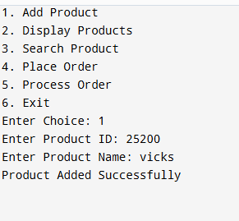
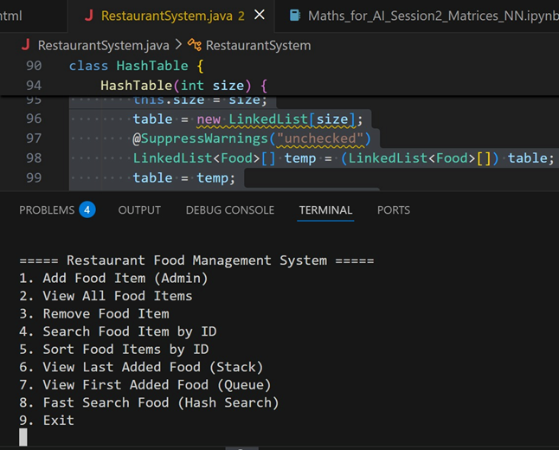
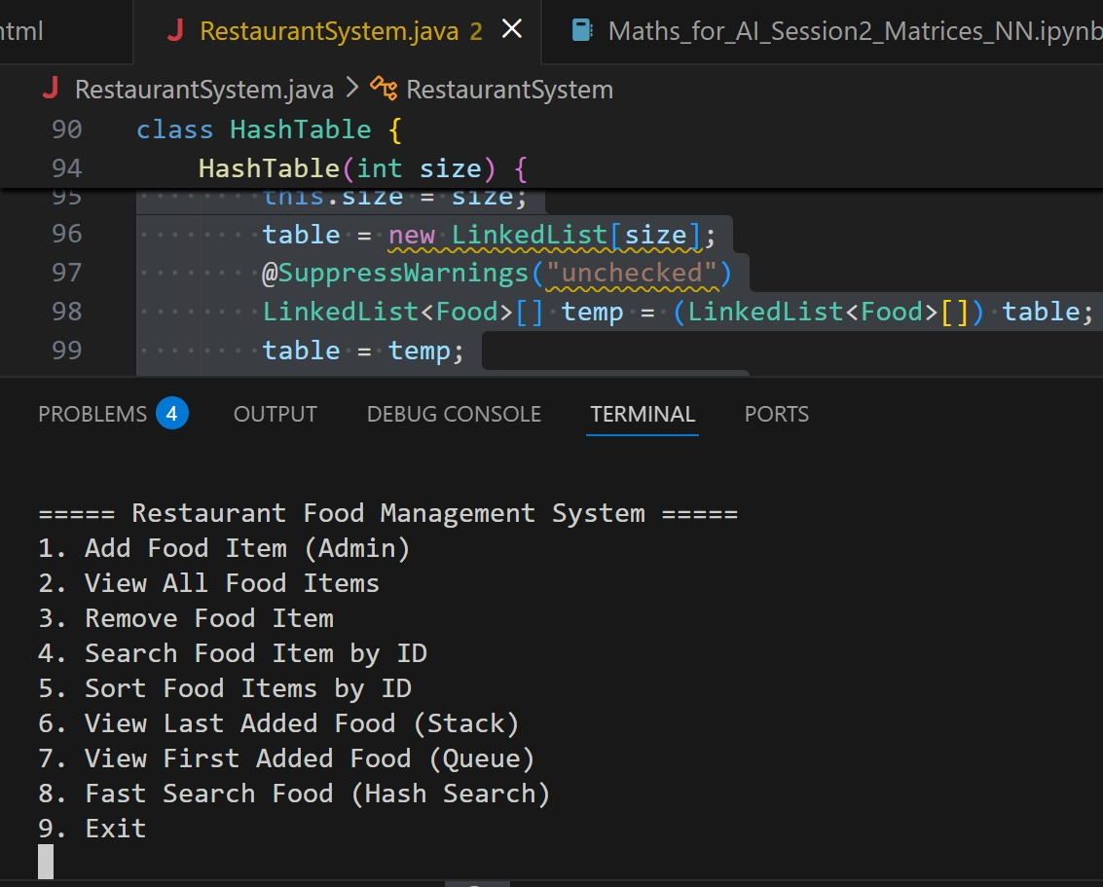
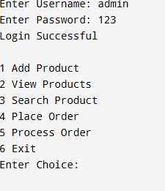
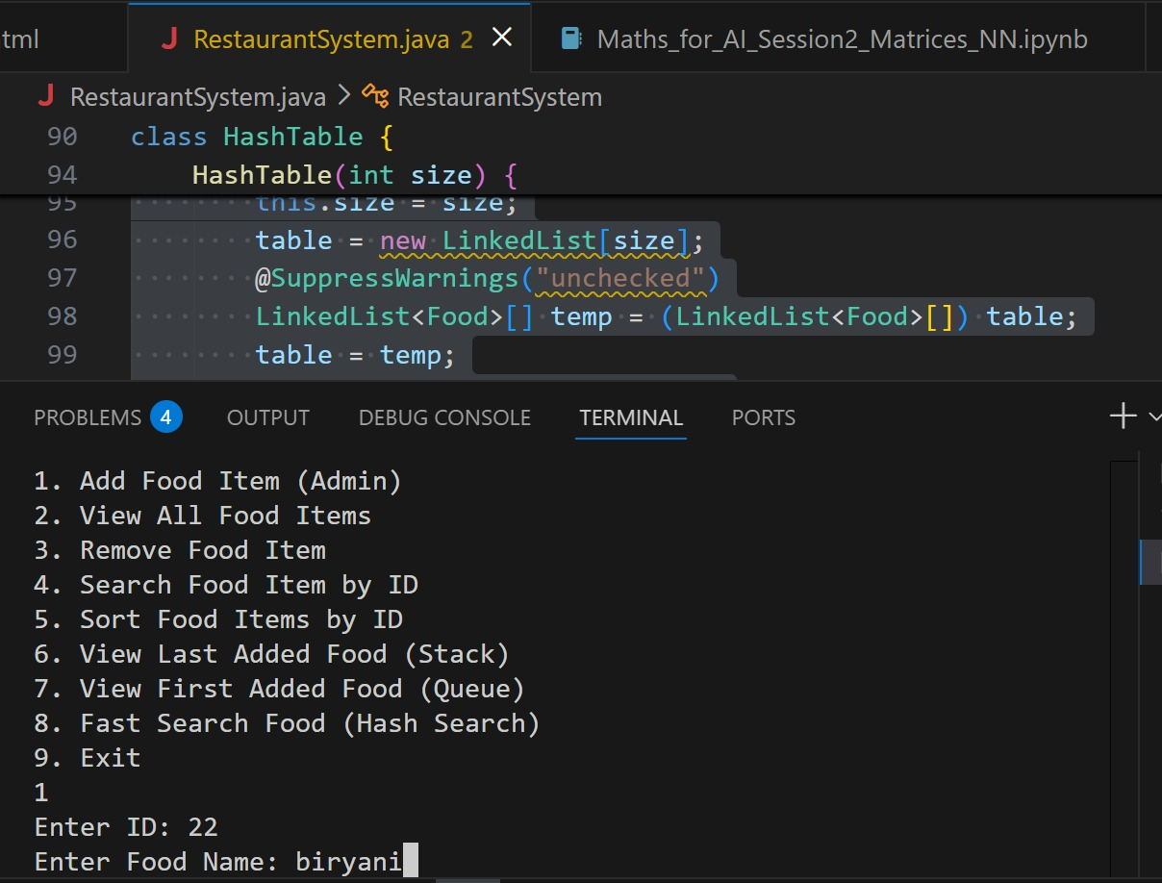
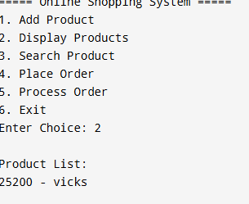
Screenshots for DSA
1st Interface
Choosing Option 1

Slide 19
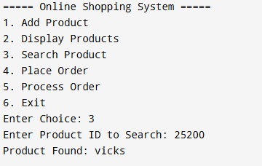
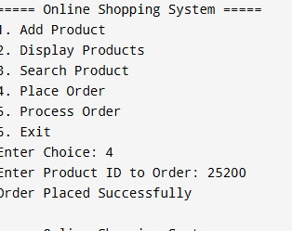
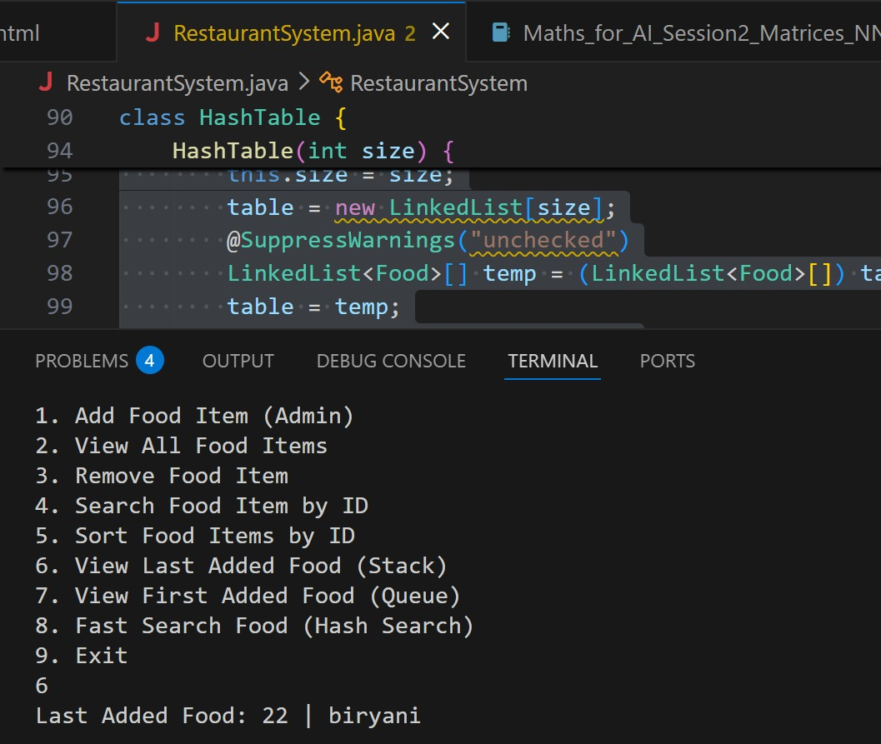
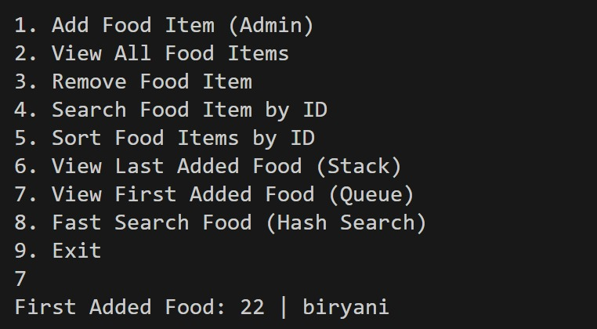
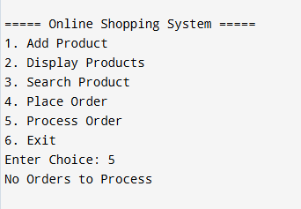
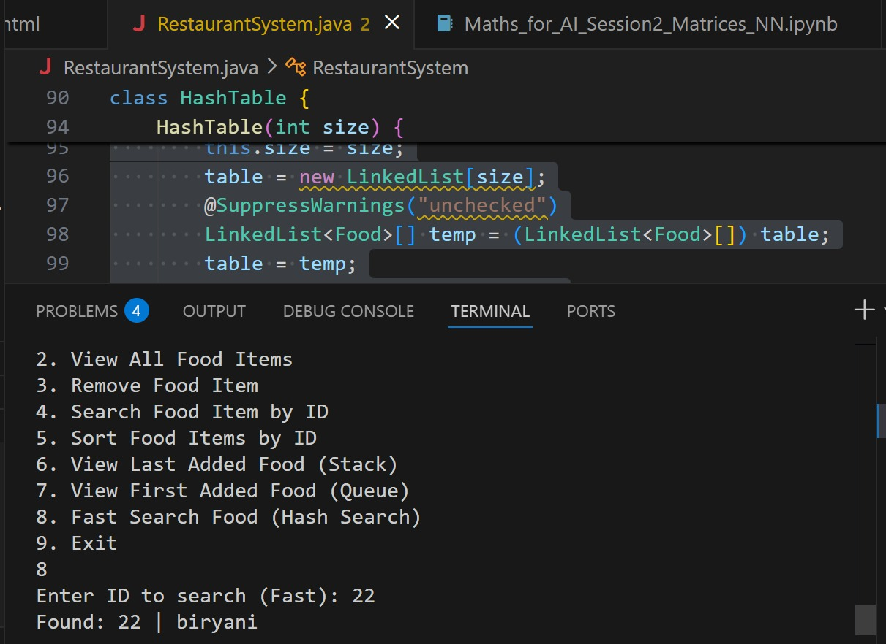
Screenshots for DSA
Choosing Option 4
Choosing Option 3
Choosing Option 5

Slide 20
Conclusion
•The Smart Online Marketplace for Local Vendors successfully bridges the gap between traditional markets and modern e-commerce by offering a simple, affordable, and community-focused digital platform. It empowers small vendors with tools for product management, real-time inventory updates, secure transactions, and data-driven insights, while providing customers with convenient access to nearby sellers through location-based search.
By integrating responsive design, scalable architecture, and analytics, the system not only enhances the buying and selling experience but also promotes sustainable community development and strengthens local economies. This project demonstrates the practical application of software engineering principles, data structures, and modern web technologies, making it a valuable solution adaptable to diverse communities.

Slide 21
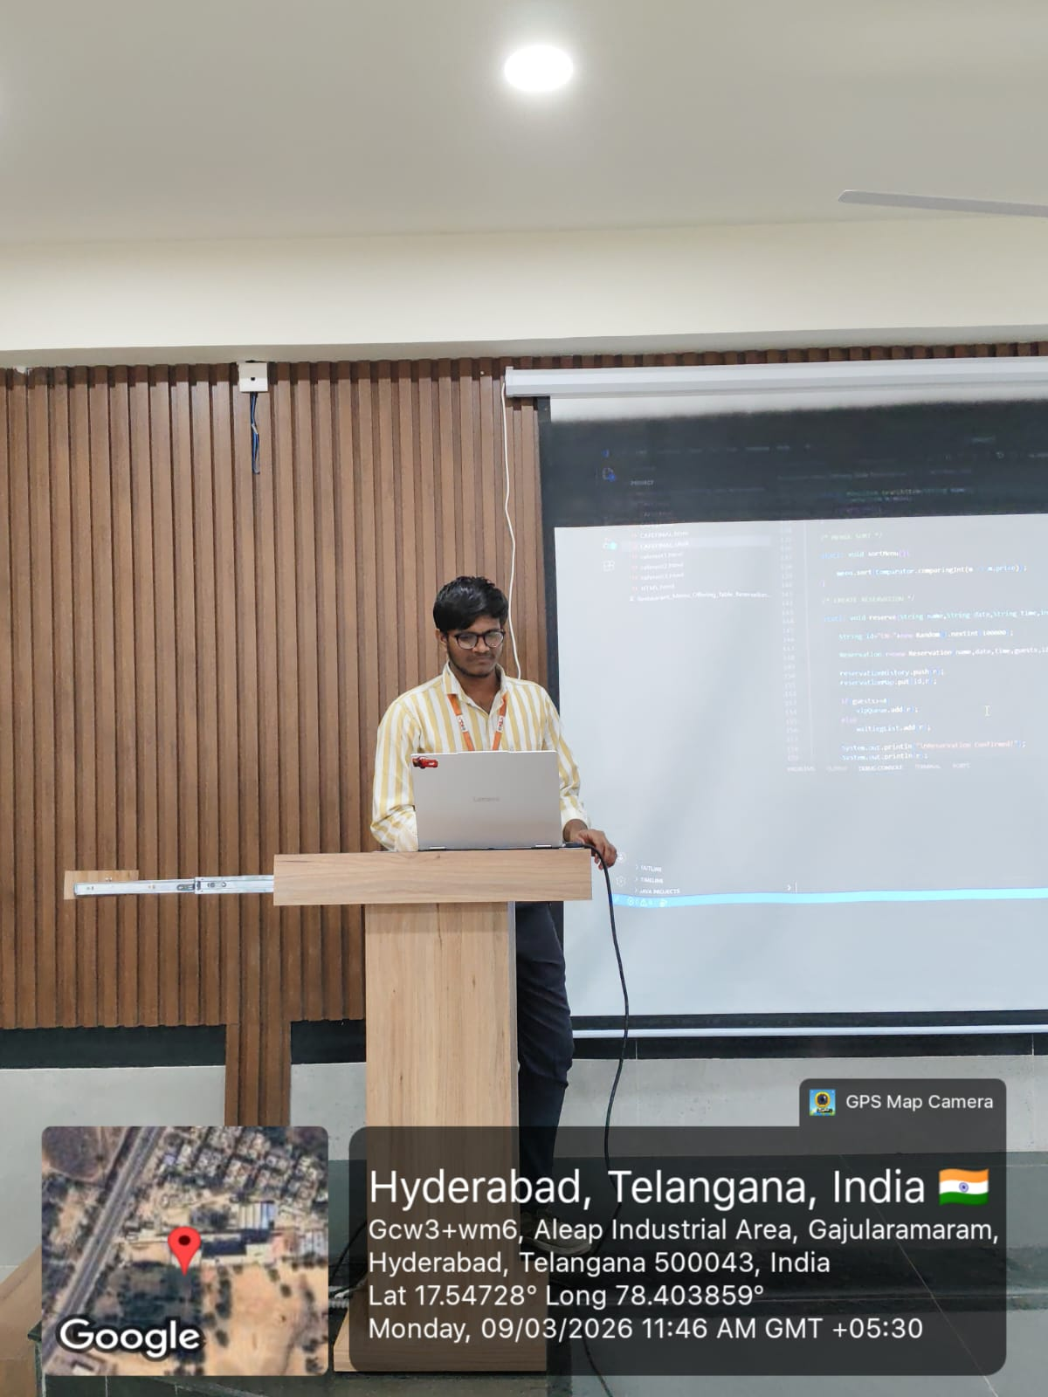
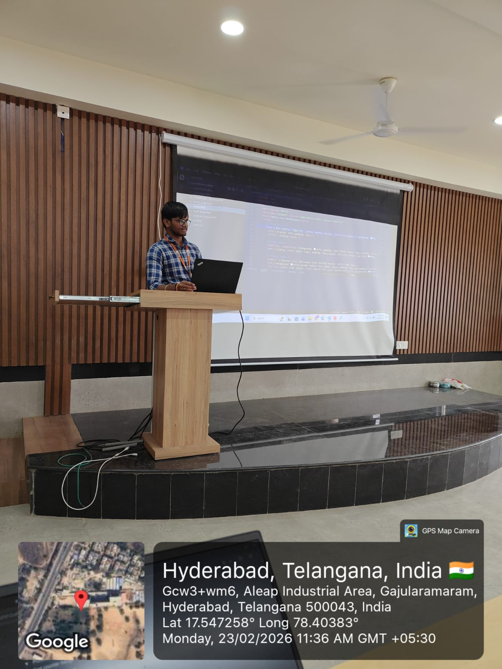
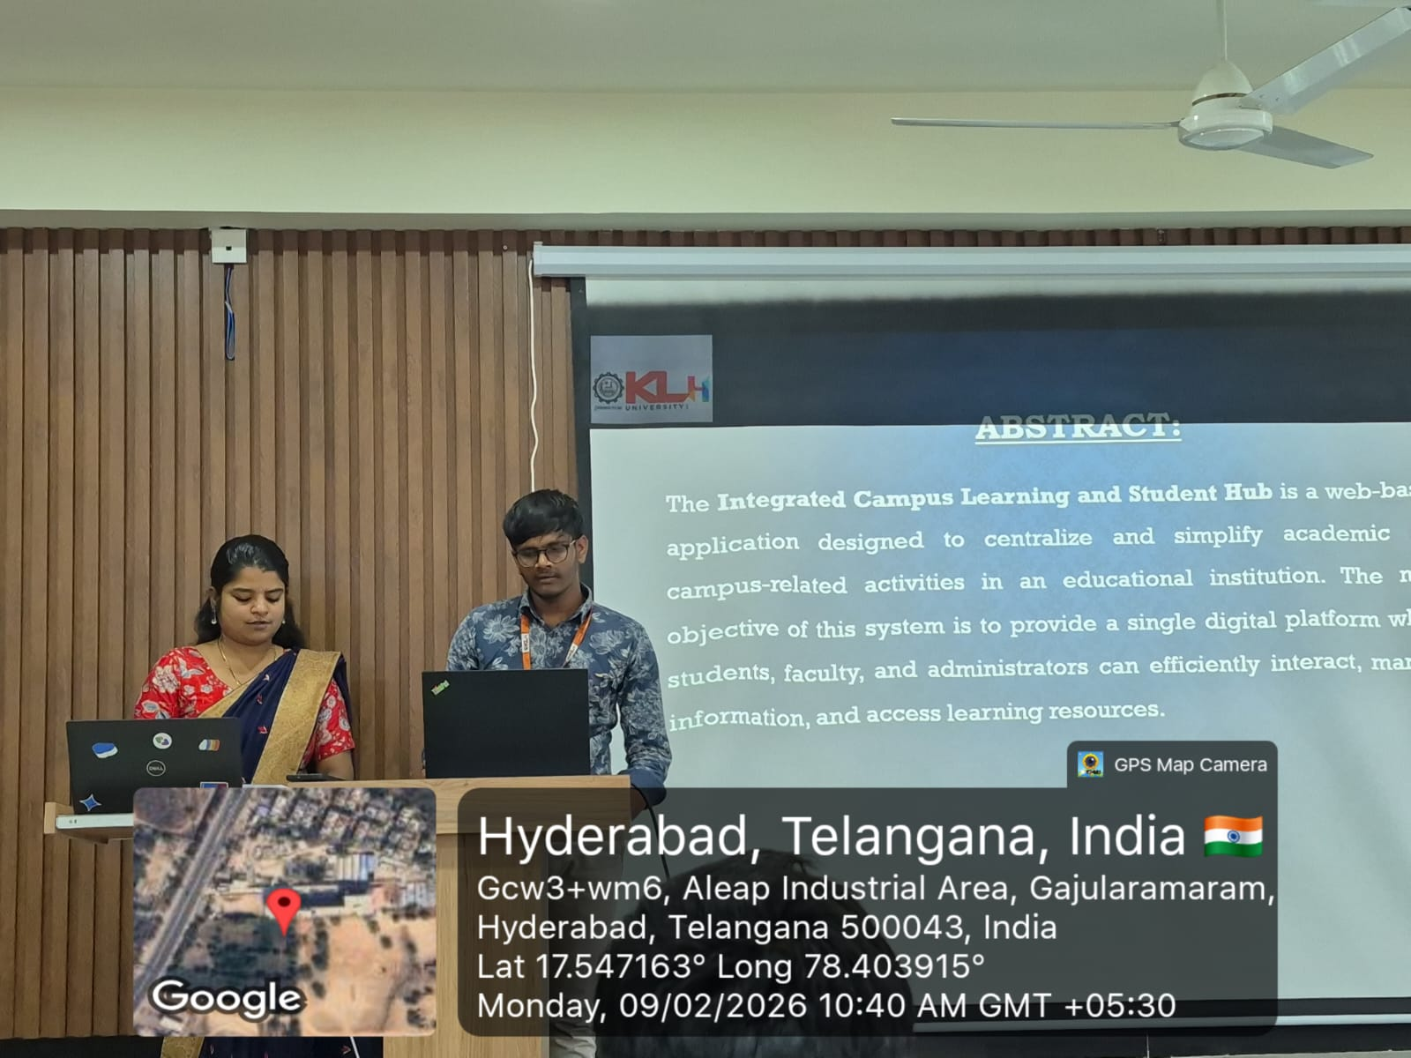
Geo- Tag Photos

Slide 22
THANK YOU

